Slide 1
Transforming steering controls to self driving
Week 6 report
Hongshuo Wang
Professor Siu Ling Leung

Slide 2
What I did
Train Yolo v5 in Google colab
Train SSDmobile v2 in Google colab
Install the tensorflow in jetbot

Slide 3
Rotoflow
Free App to do the data augmentation and transform your data set into specific version
Also include the online colab training
https://towardsdatascience.com/how-to-train-a-custom-object-detection-model-with-yolo-v5-917e9ce13208

Slide 4
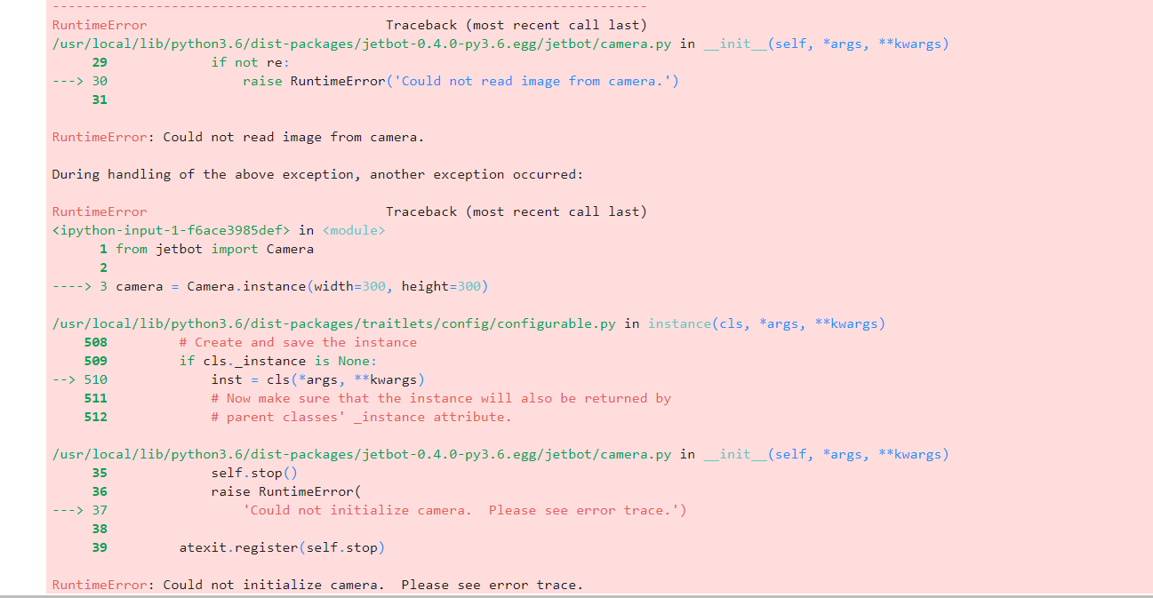
Image Issue

Slide 5
Fixed by reinstalling the system
The jetbot is highly sensitive with software version

Slide 6
Currently Biggest Issue
Jetbot computing and memory limit
Jetbot doesn’t support any newest high performance object detection model
Runtime error frequently shows up unless you use lab code to train the simple model which has poor performance
Cannot find any suitable outside model without using Nvidia tool
only have 40 GB currently on computer => Cannot have linux system and Nvidia GPU

Slide 7
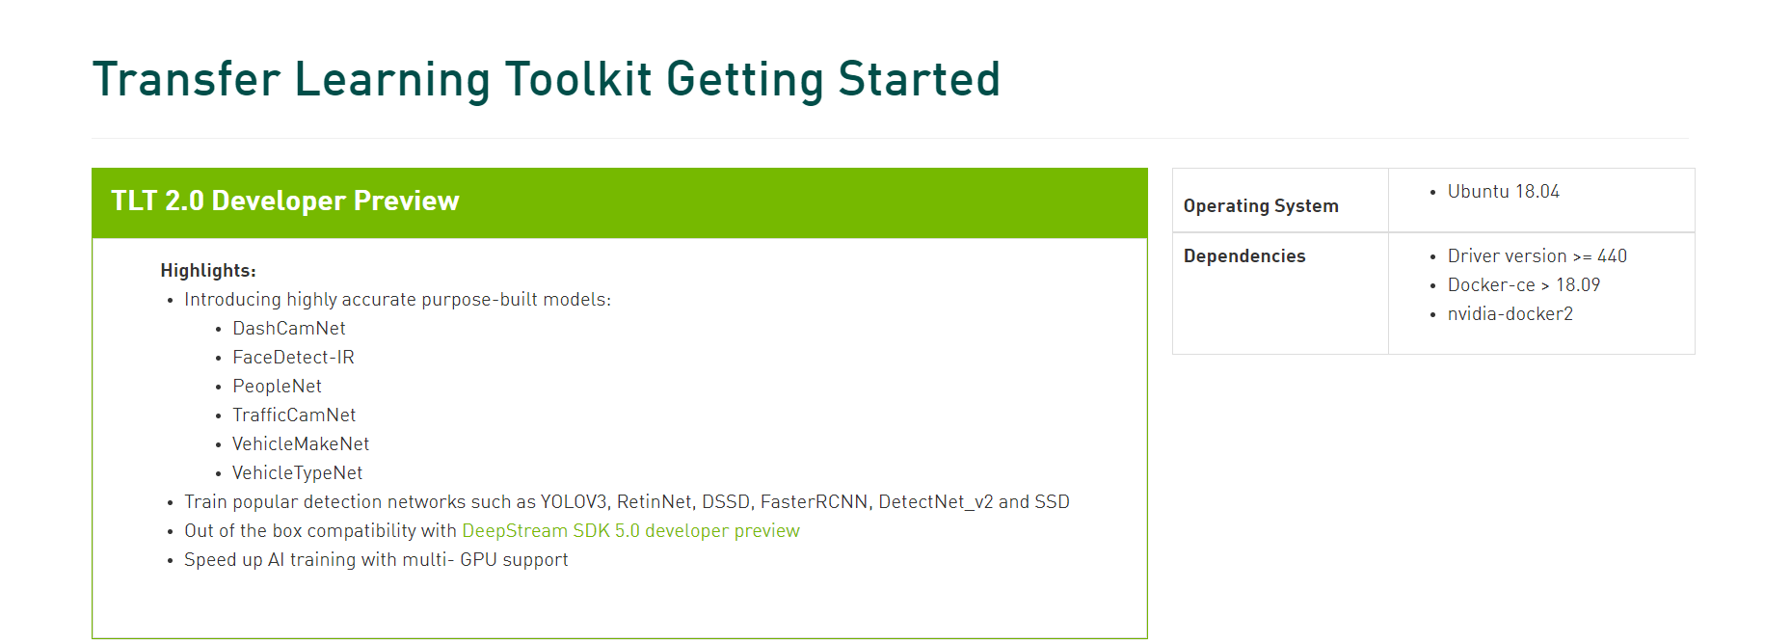
The Basic Requirement of Nvidia API

Slide 8
Why other models have poor performance on Jetbot
Can not find a way to transform trained weight (such as plt and pb file ) into engine file or Tensor RT file
Jetbot have only 2 GB RAM
Jetbot doesn’t support the Anaconda (You have to manually install all the required packages)

